Slide 1

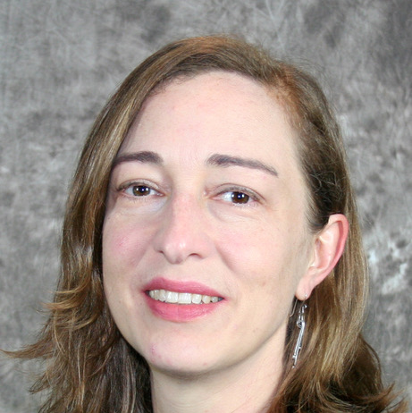
Emily Dykhuizen, Ph.D.
Purdue University
“The function and inhibition of histone “reader” domains found within chromatin remodeling complexes”
Tuesday, December 5, 2023
10:30 am
Biochemistry Seminar Room, 264 McDonnell Science
Host: Ben Garcia
(Refreshments provided)

