Slide 1

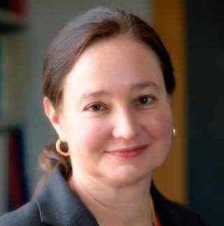
Sarah Woodson, Ph.D.
Johns Hopkins University
“Matchmaking by small RNAs and the Hfq chaperone”
Tuesday, November 14, 2023
10:30 am
Biochemistry Seminar Room, 264 McDonnell Science
Host: Tim Lohman
(Refreshments provided)

