Slide 1

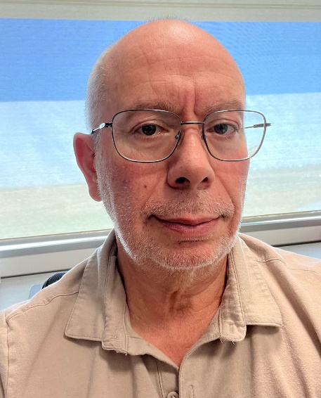
Victor Muñoz, Ph.D.
University of California, Merced
“Efficient DNA Scanning without Clamping Support by Eukaryotic Transcription Factors: Leveraging Promiscuous Recognition with Conformational Control”
Monday, October 30, 2023
10:30 am
Biochemistry Seminar Room, 264 McDonnell Science
Host: Andrea Soranno
(Refreshments provided)

